Slide 1
Divide and Conquer Algorithms
High level review of technique and example application

Slide 2
Divide and conquer technique
Divide: This involves dividing the problem into smaller sub-problems.
Conquer: Solve sub-problems by calling recursively until solved.
Combine: Combine the sub-problems to get the final solution of the whole problem.

Slide 3
Pseudocode of overall strategy
DAC(a, i, j)
{
if(small(a, i, j))
return(Solution(a, i, j))
else
m = divide(a, i, j) // f1(n)
b = DAC(a, i, mid) // T(n/2)
c = DAC(a, mid+1, j) // T(n/2)
d = combine(b, c) // f2(n)
return(d)
}
Recurrence relation for non-trivial n:
T(n) = f1(n) + 2T(n/2) + f2(n)
Can you estimate time complexity O(.)?

Slide 4
How to apply to specific problems?
To use D&C we need to define:
A base case (naïve solution to problem used to exit recursion).
A divide function that splits our problem approximately in half.
A recursive definition of our solver.
A method to combine partial solutions into complete answer.

Slide 5
Concrete example: Mergesort
To use D&C we need to define:
A base case -> naïve sort method
A divide function that splits our problem approximately in half -> split array in middle
A recursive definition of our solver -> call mergesort function on each array half
A method to combine partial solutions into complete answer -> merge

Slide 6
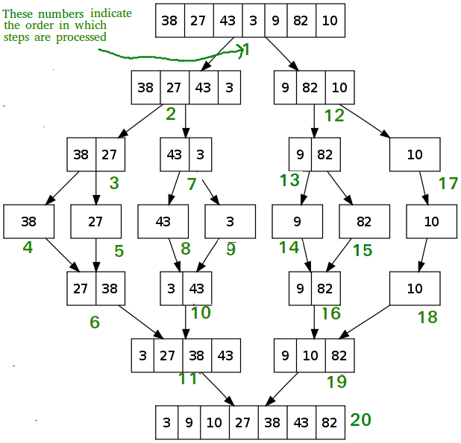
How does mergesort work?
Image credit: Geeksforgeeks.org

Slide 7
Pseudocode
MergeSort(arr[], l, r)
If r > l
1. Find the middle point to divide the array into two halves:
middle m = l + (r-l)/2
2. Call mergeSort for first half:
Call mergeSort(arr, l, m)
3. Call mergeSort for second half:
Call mergeSort(arr, m+1, r)
4. Merge the two halves sorted in step 2 and 3:
Call merge(arr, l, m, r)

